Slide 1









Compiler
Project
Linked List
SPRING 2023

Slide 2



Project overview
we will Convert mini-Java program (linked List) to Antler code with Backus-Naur Form (BNF).

Slide 3



Linked List:
A linked list is a common data structure used in computer science and programming. It is a collection of nodes where each node contains a value and a reference (or link) to the next node in the sequence. The last node in the list typically has a reference to null, indicating the end of the list.
Node 1 Node 2 Node 3
+------+ +------+ +------+
| 5 | | 10 | | 15 |
| next |--> | next |--> | next |--> null
+------+ +------+ +------+

Slide 4

properties:
1
2
3
4
1
2
3
4
Dynamic Size: Linked lists can grow or shrink dynamically as elements are added or removed.
Sequential Access: Elements in a linked list are accessed sequentially by following the links from one node to the next.
Insertion and Deletion: Inserting or deleting an element in a linked list involves adjusting the references of neighboring nodes, which can be done efficiently.
Random Access: Unlike arrays, linked lists do not provide direct access to arbitrary positions in the list. Accessing an element at a specific position requires traversing the list from the beginning.

Slide 5





our proplem
Our program is applying the CRUD operation, Comparing among the employees in terms of age, salary and marital status
using the data structure Linked List.

Slide 6
class LinkedList{
public static void main(String[] a){
System.out.println(new LL().Start()); } }
class Element {
int Age ;
int Salary ;
boolean Married ;
// Initialize some class variables
public boolean Init(int v_Age, int v_Salary, boolean v_Married){
Age = v_Age ;
Salary = v_Salary ;
Married = v_Married ;
return true ; }
public int GetAge(){
return Age ; }
// This method returns true if the object "other"
// has the same values for age, salary and
public boolean Equal(Element other){
boolean ret_val ;
int aux01 ;
int aux02 ;
int nt ;
ret_val = true ;
aux01 = other.GetAge();
if (!this.Compare(aux01,Age)) ret_val = false ;
else {
aux02 = other.GetSalary();
if (!this.Compare(aux02,Salary)) ret_val = false ;
else
if (Married)
if (!other.GetMarried()) ret_val = false;
else nt = 0 ;
else
if (other.GetMarried()) ret_val = false;
else nt = 0 ; }
return ret_val ;
}
public int GetSalary(){
return Salary ; }
public boolean GetMarried(){
return Married ; }

Slide 7
// This method compares two integers and
// returns true if they are equal and false
// otherwise
public boolean Compare(int num1 , int num2){
boolean retval ;
int aux02 ;
retval = false ;
aux02 = num2 + 1 ;
if (num1 < num2) retval = false ;
else if (!(num1 < aux02)) retval = false ;
else retval = true ;
return retval ; } }
class List{
Element elem ;
List next ;
boolean end ;
// Initialize the node list as the last node
public boolean Init(){
end = true ;
return true ; }
// Initialize the values of a new node
public boolean InitNew(Element v_elem, List v_next, boolean v_end){ end = v_end ;
elem = v_elem ;
next = v_next ;
return true ; }
// Insert a new node at the beginning of the list
public List Insert(Element new_elem){
boolean ret_val ;
List aux03 ;
List aux02 ;
aux03 = this ;
aux02 = new List();
ret_val = aux02.InitNew(new_elem,aux03,false);
return aux02 ; }
// Update the the pointer to the next node
public boolean SetNext(List v_next){
next = v_next ;
return true ; }
// Delete an element e from the list
public List Delete(Element e){
List my_head ;
boolean ret_val ;
boolean aux05;
List aux01 ;
List prev ;
boolean var_end ;
Element var_elem ;
int aux04 ;
int nt ;

Slide 8
my_head = this ;
ret_val = false ;
aux04 = 0 - 1 ;
aux01 = this ;
prev = this ;
var_end = end;
var_elem = elem ;
while ((!var_end) && (!ret_val)){
if (e.Equal(var_elem)){
ret_val = true ;
if (aux04 < 0) {
// delete first element
my_head = aux01.GetNext() ; }
else{ // delete a non first element
System.out.println(0-555);
aux05 = prev.SetNext(aux01.GetNext());
System.out.println(0-555); } }
else nt = 0 ;
if (!ret_val){
prev = aux01 ;
aux01 = aux01.GetNext() ;
var_end = aux01.GetEnd();
var_elem = aux01.GetElem();
aux04 = 1 ;
} else nt = 0 ; }
return my_head ; }
// Search for an element e on the list
public int Search(Element e){
int int_ret_val ;
List aux01 ;
Element var_elem ;
boolean var_end ;
int nt ;
int_ret_val = 0 ;
aux01 = this ;
var_end = end;
var_elem = elem ;
while (!var_end){
if (e.Equal(var_elem)){
int_ret_val = 1 ; }
else nt = 0 ;
aux01 = aux01.GetNext() ;
var_end = aux01.GetEnd();
var_elem = aux01.GetElem(); }
return int_ret_val ; }
public boolean GetEnd(){
return end ; }
public Element GetElem(){
return elem ; }
public List GetNext(){
return next ; }

Slide 9
// Print the linked list
public boolean Print(){
List aux01 ;
boolean var_end ;
Element var_elem ;
aux01 = this ;
var_end = end ;
var_elem = elem ;
while (!var_end){
System.out.println(var_elem.GetAge());
aux01 = aux01.GetNext() ;
var_end = aux01.GetEnd();
var_elem = aux01.GetElem(); }
return true ; } }
// this class invokes the methods to insert, delete,
// search and print the linked list
class LL{
public int Start(){
List head ;
List last_elem ;
boolean aux01 ;
Element el01 ;
Element el02 ;
Element el03 ;
last_elem = new List();
aux01 = last_elem.Init();
head = last_elem ;
aux01 = head.Init();
aux01 = head.Print();
// inserting first element
el01 = new Element();
aux01 = el01.Init(25,37000,false);
head = head.Insert(el01);
aux01 = head.Print();
System.out.println(10000000);
// inserting second element
el01 = new Element();
aux01 = el01.Init(39,42000,true);
el02 = el01 ;
head = head.Insert(el01);
aux01 = head.Print();
System.out.println(10000000);
// inserting third element
el01 = new Element();
aux01 = el01.Init(22,34000,false);
head = head.Insert(el01);
aux01 = head.Print();
el03 = new Element();
aux01 = el03.Init(27,34000,false);
System.out.println(head.Search(el02));
System.out.println(head.Search(el03));
System.out.println(10000000);
// inserting fourth element
el01 = new Element();
aux01 = el01.Init(28,35000,false);
head = head.Insert(el01);
aux01 = head.Print();
System.out.println(2220000);
head = head.Delete(el02);
aux01 = head.Print();
System.out.println(33300000);
head = head.Delete(el01);
aux01 = head.Print();
System.out.println(44440000);
return 0 ; } }

Slide 10


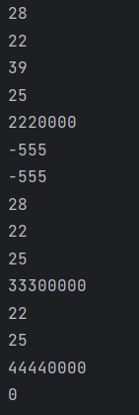

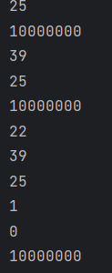



output

Slide 11
What is BNF?
BNF stands for Backus-Naur Form. It is a notation used to formally describe the syntax of programming languages, as well as other formal languages. BNF was developed by John Backus and Peter Naur in the late 1950s as a tool for describing the syntax of ALGOL 60.

Slide 12
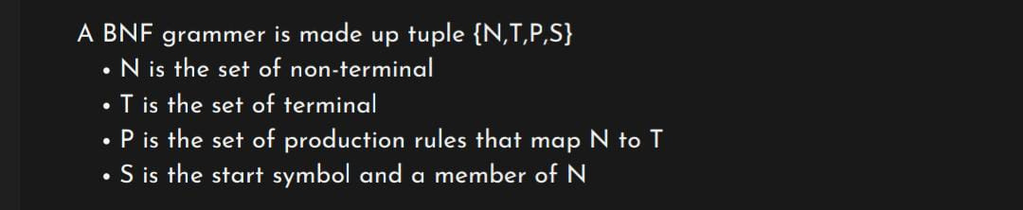
Syntax:
In BNF, the syntax of a language is defined using a set of production rules. Each rule consists of a non-terminal symbol on the left-hand side, followed by the symbol "::=" (read as "is defined as"), and a sequence of terminals and/or non-terminals on the right-hand side. Terminals represent the basic elements or tokens of the language, such as keywords, operators, and literals, while non-terminals represent syntactic elements that can be further expanded.

Slide 13
Why we Using BNf?
1- Formal Specification:
BNF provides a formal and concise way to specify the syntax of a programming language or grammar.
2- Readability:
BNF is relatively easy to read and understand, especially for those familiar with formal grammars.

Slide 14
3- Tool Support:
BNF has been widely adopted in the field of computer science, and there are many tools can helps u in the code.
4- Language Independence:
BNF is not tied to any specific programming language or technology.

Slide 15
Disadvantages:
1- Limited Expressiveness:
BNF is primarily focused on describing the syntax and structure of a language.
2- lack of standardization:
can lead to inconsistencies and compatibility issues when working with different BNF variants.

Slide 16
3- Maintenance Overhead:
BNF specifications can become complex and hard to maintain, especially for large and evolving languages.

Slide 17
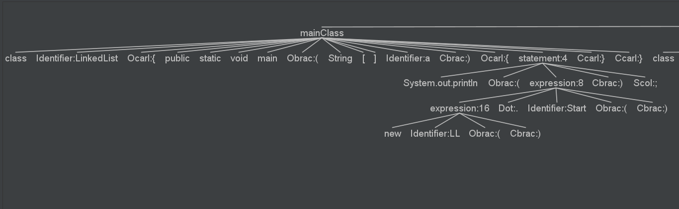
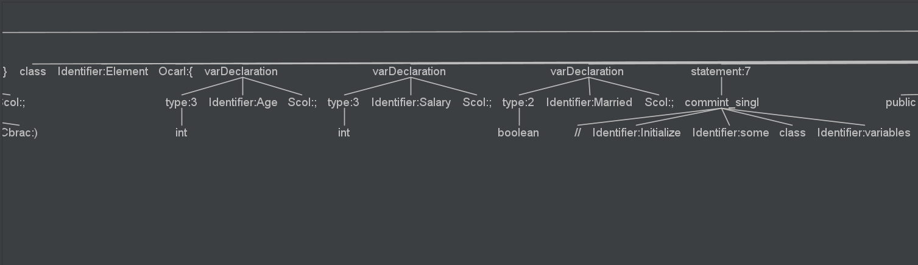
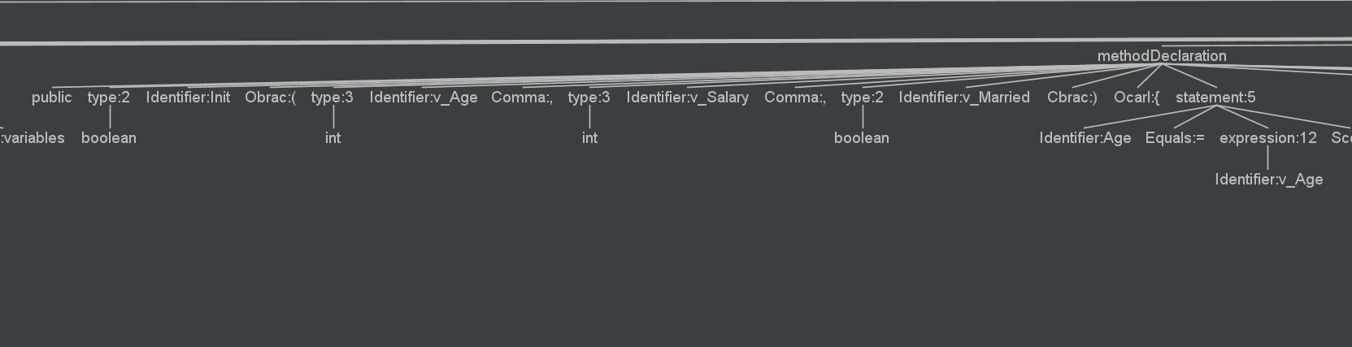

Slide 18
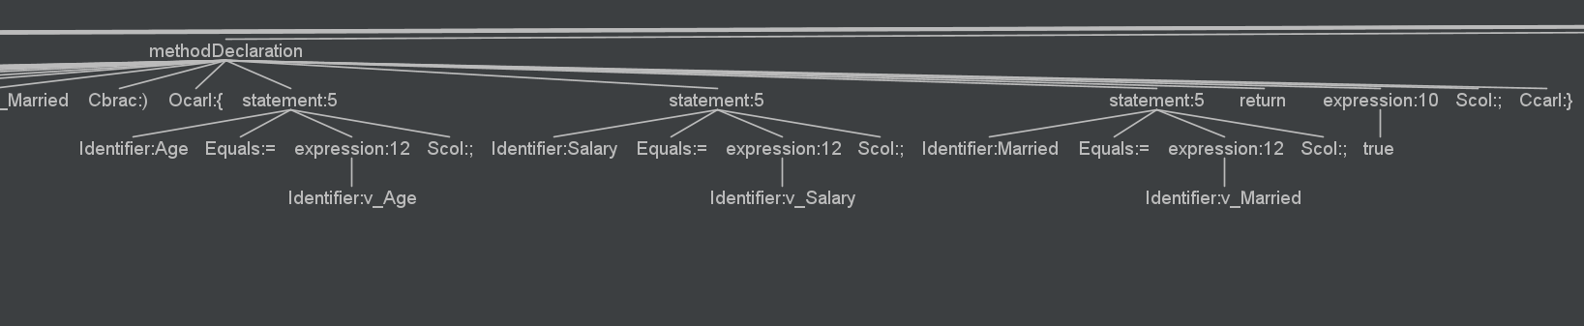
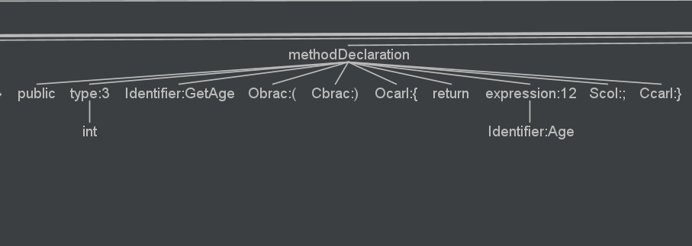
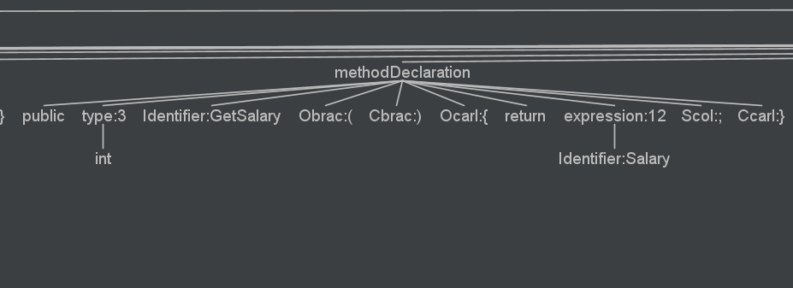

Slide 19
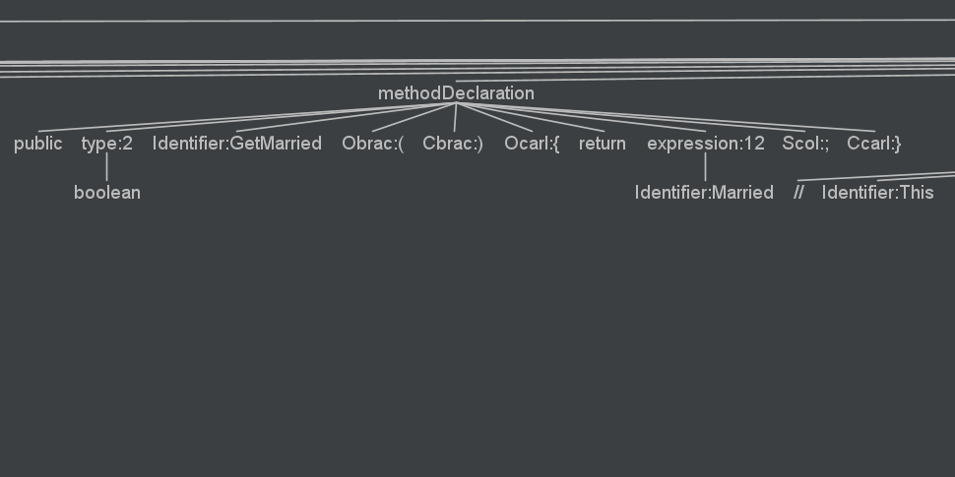
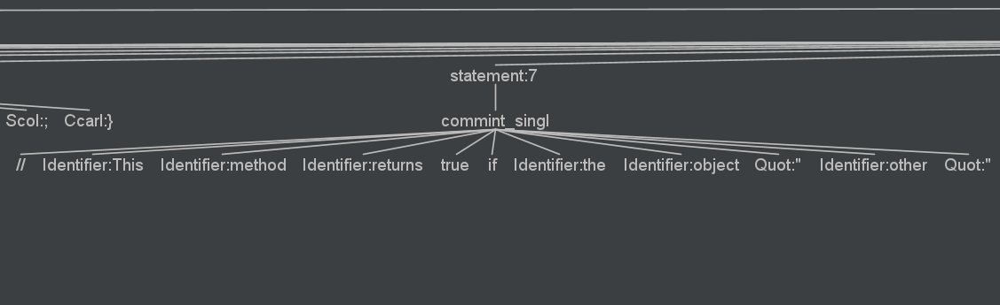
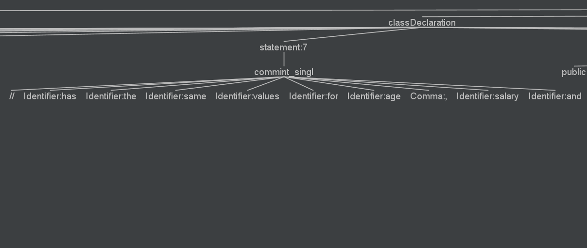

Slide 20
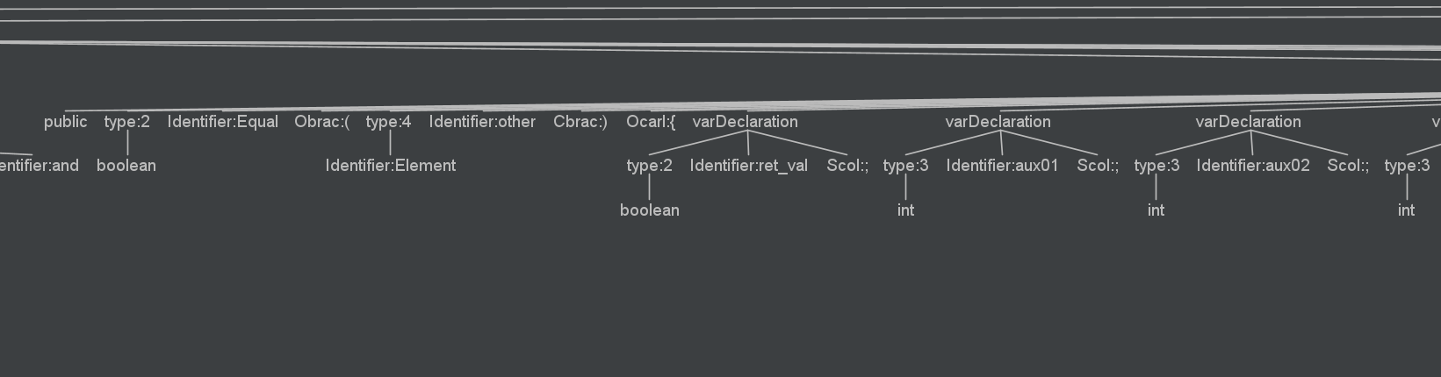
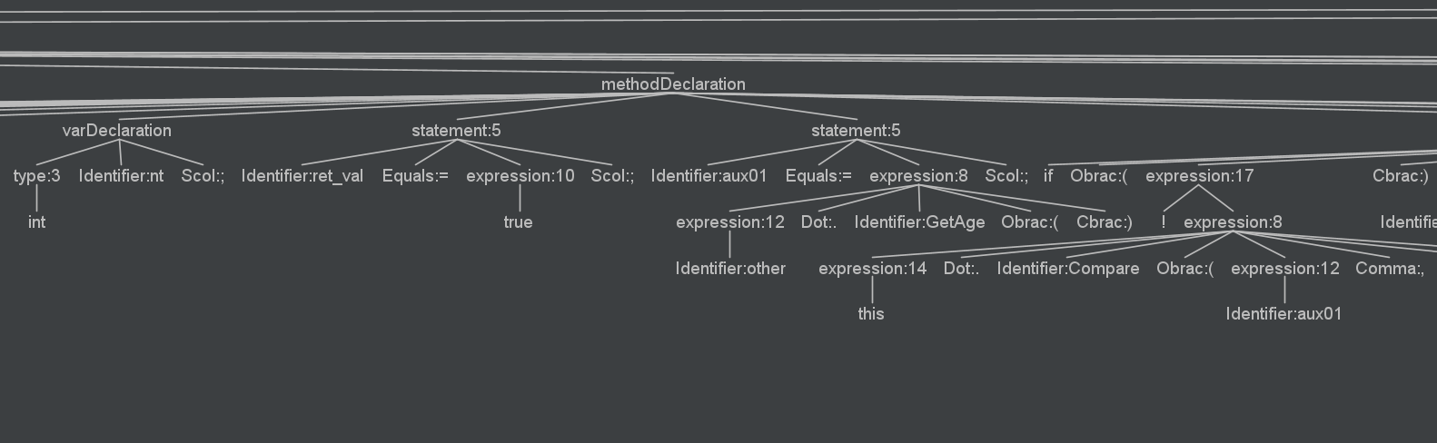
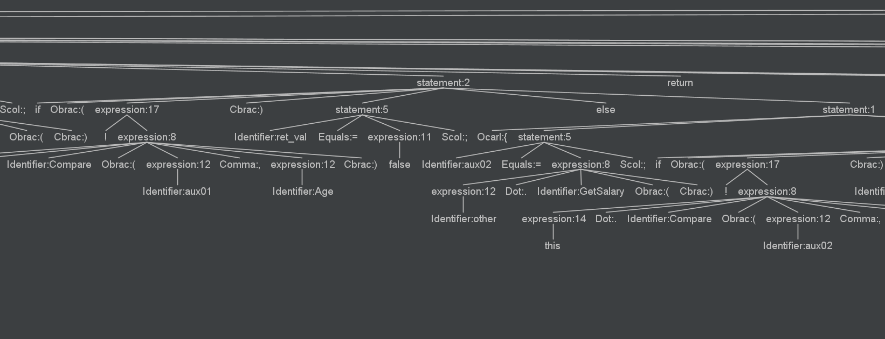

Slide 21
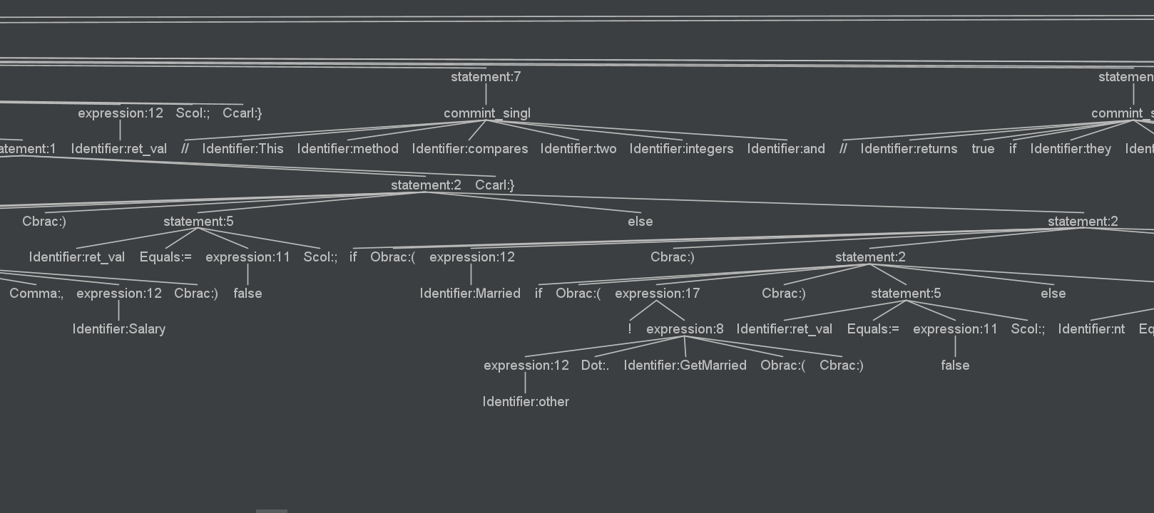
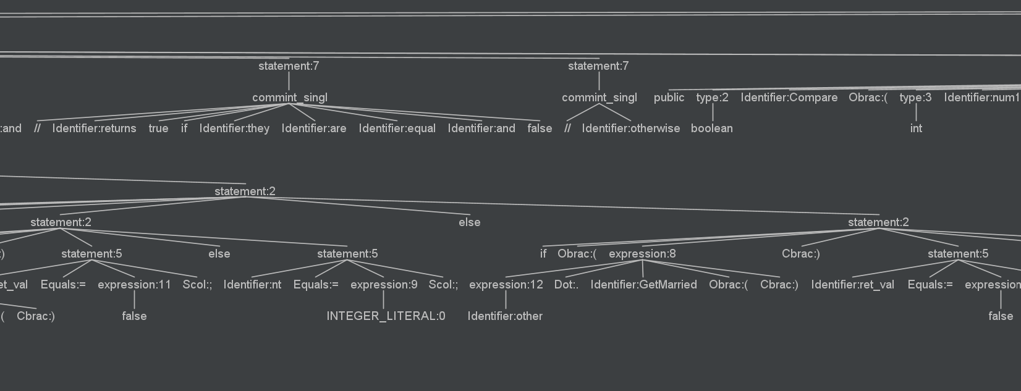

Slide 22
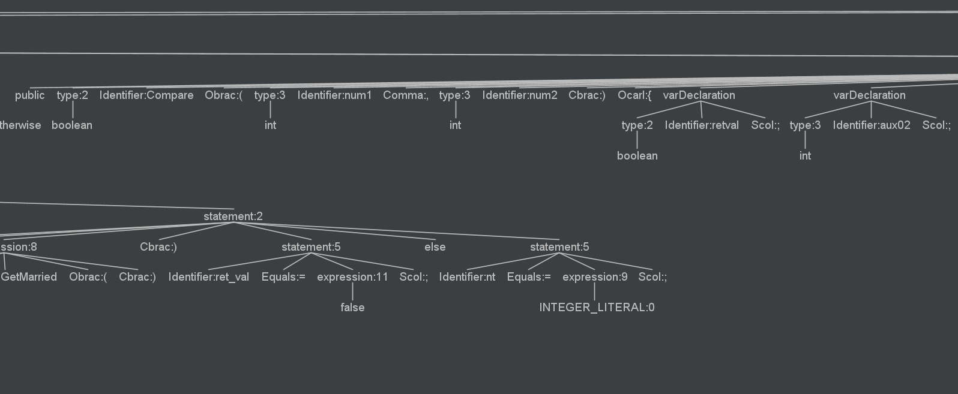
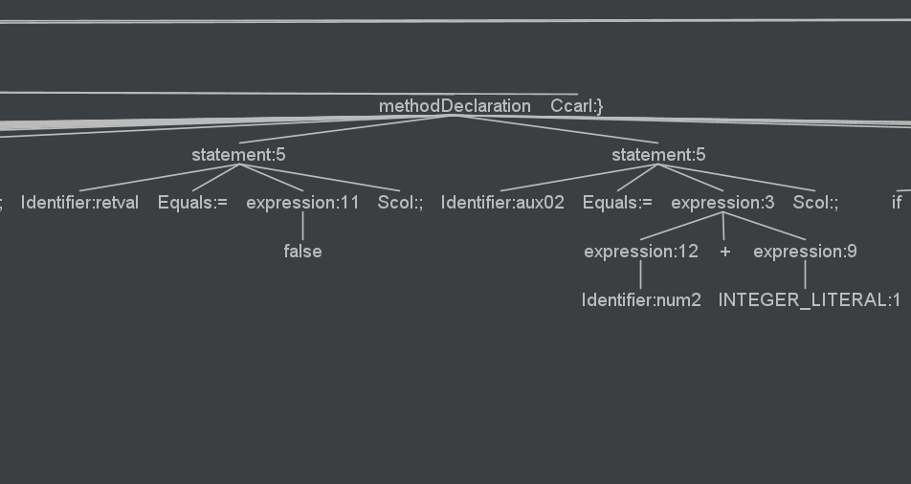

Slide 23
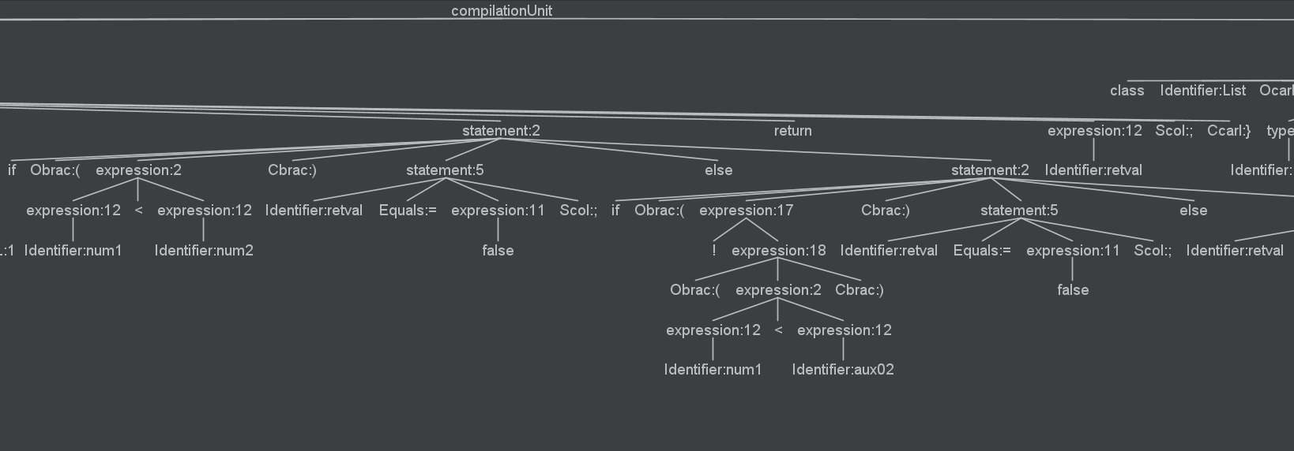
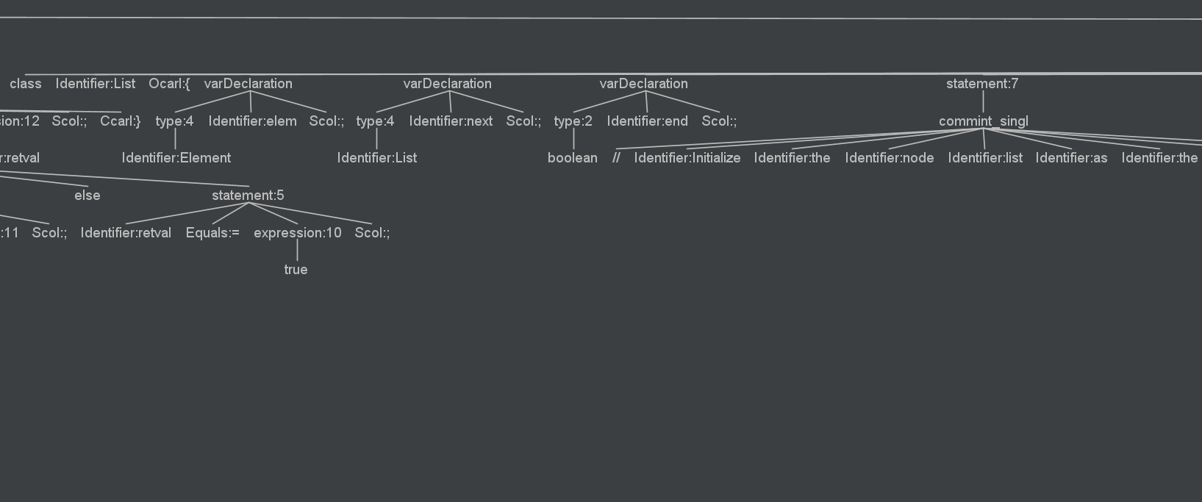

Slide 24
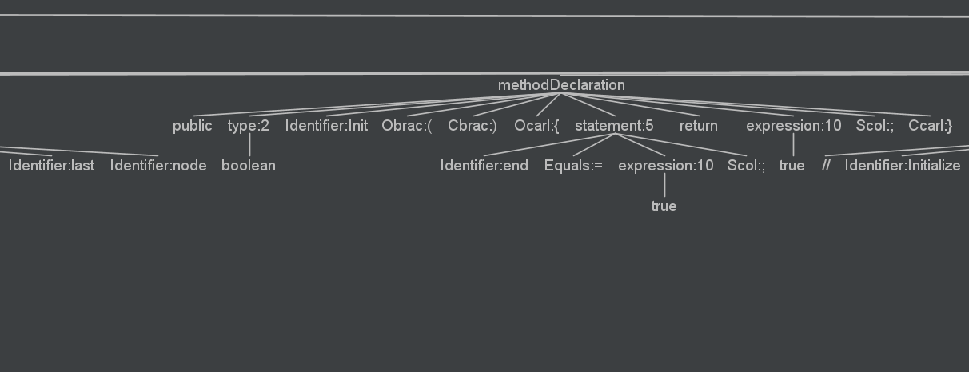
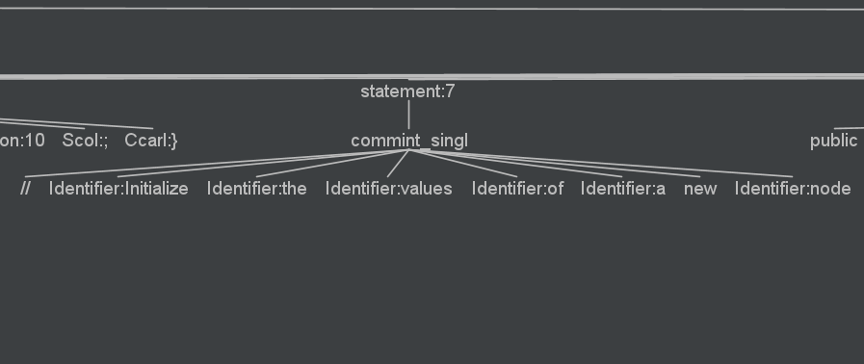

Slide 25
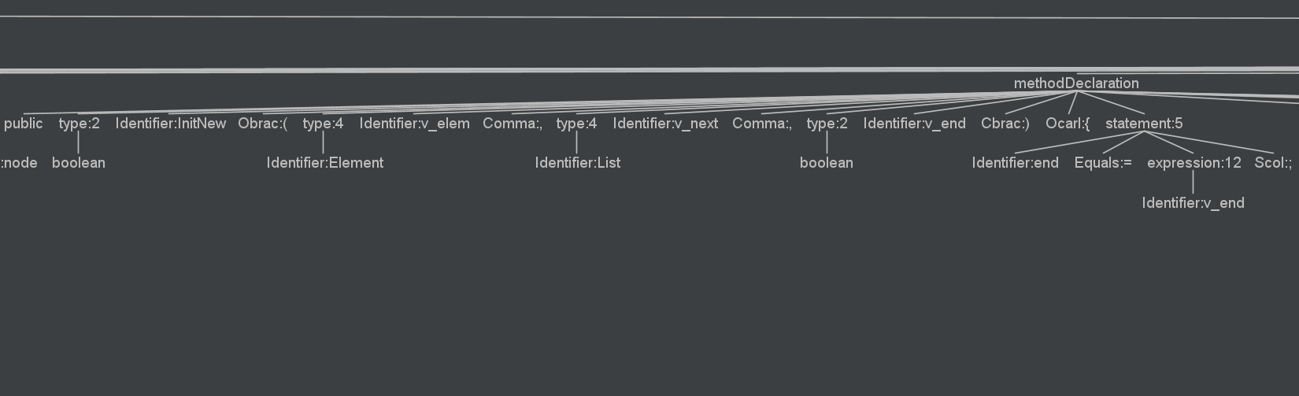
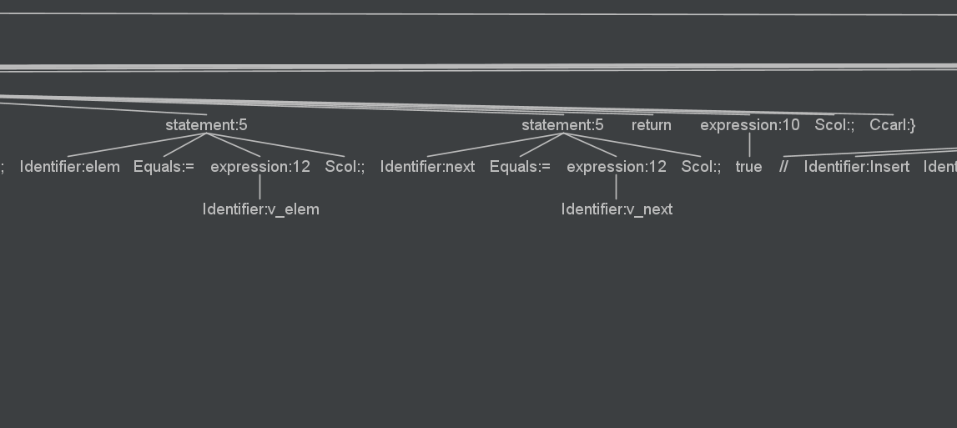
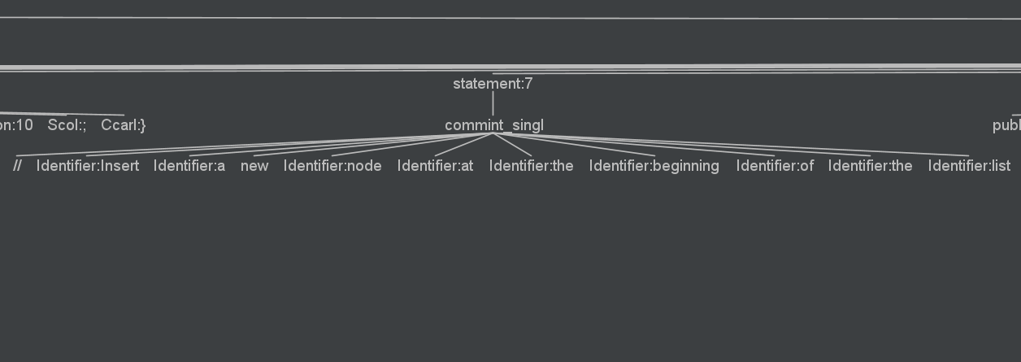

Slide 26
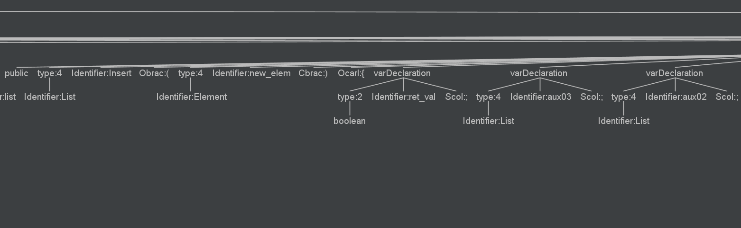
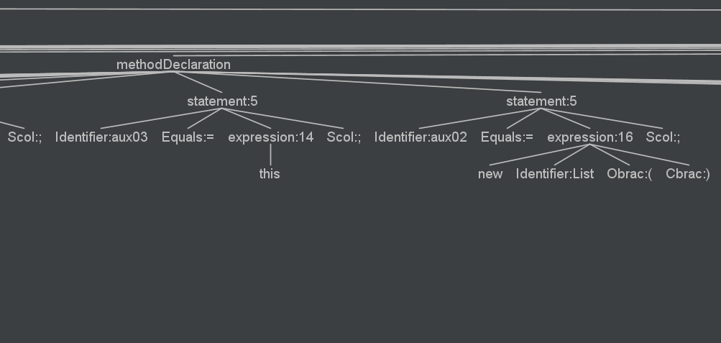
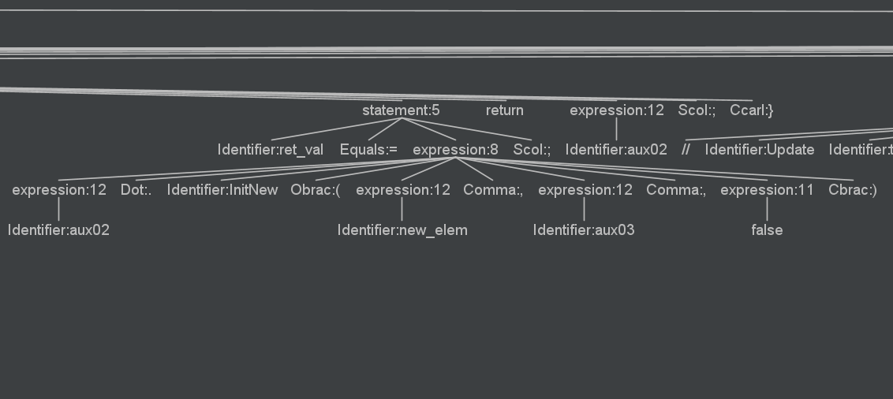

Slide 27
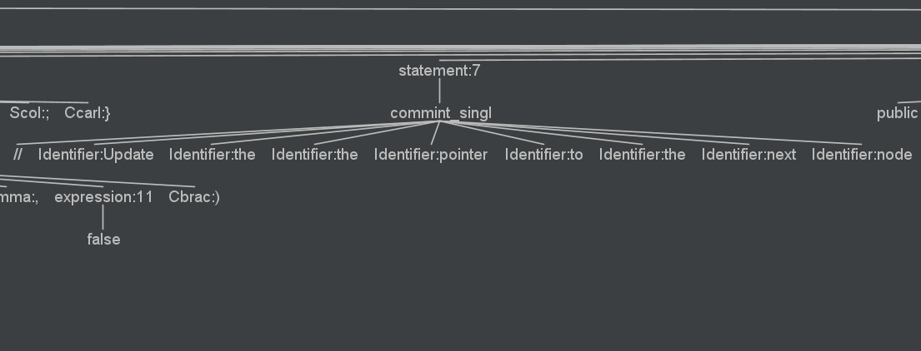
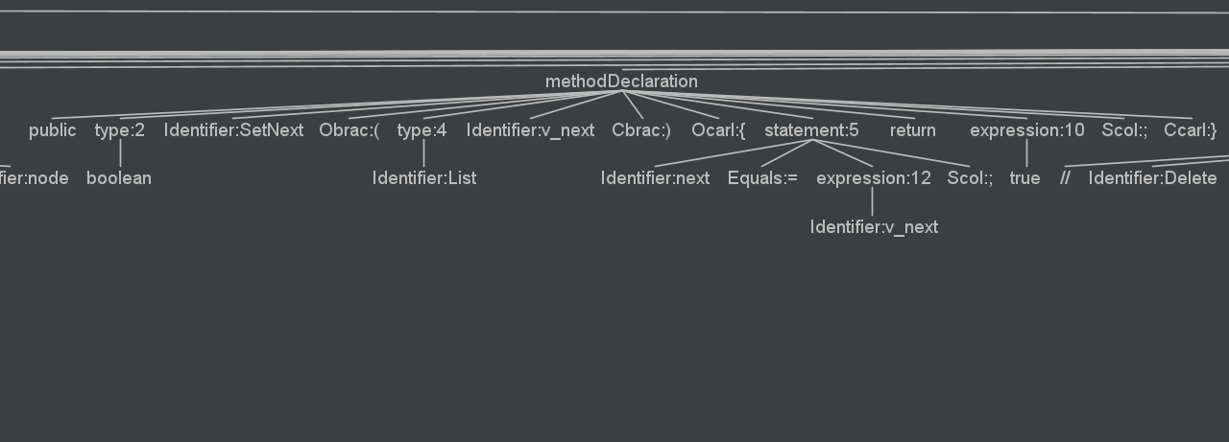
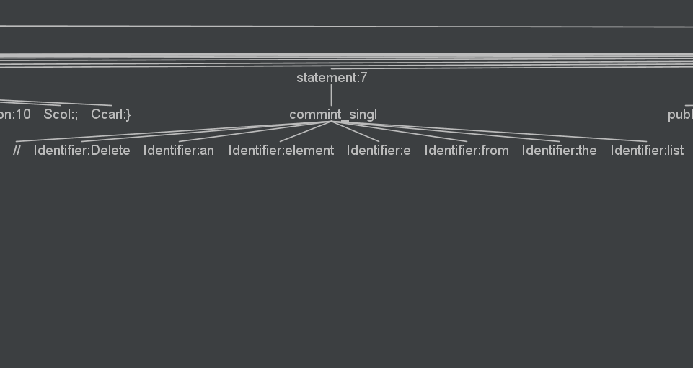

Slide 28
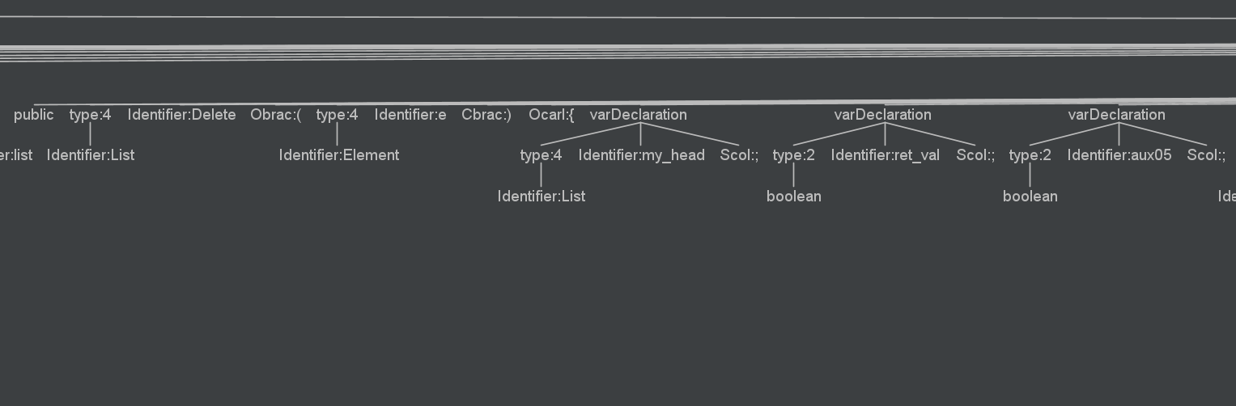
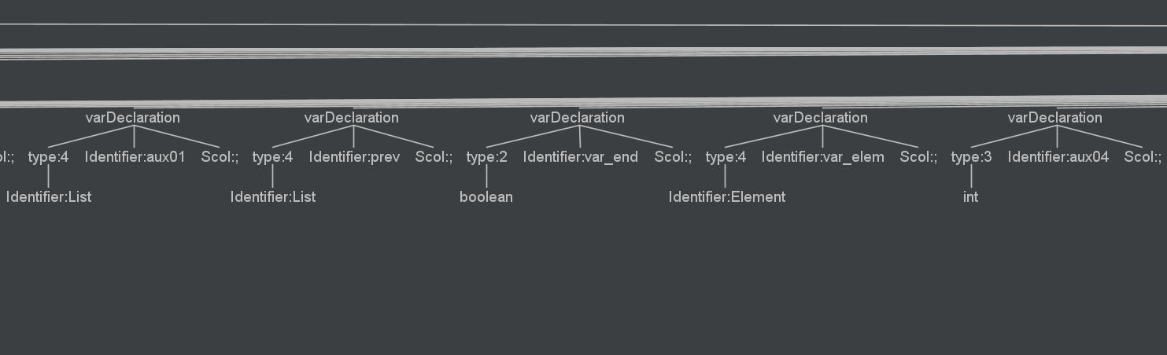
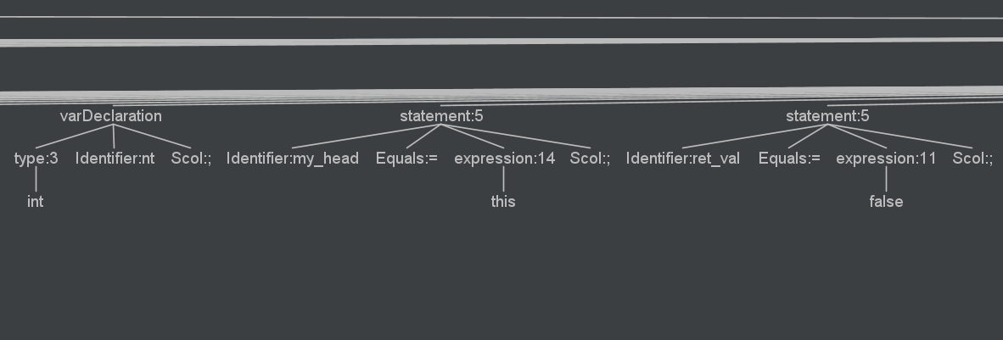

Slide 29
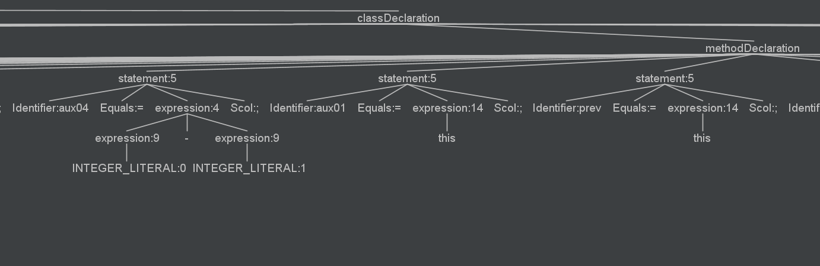
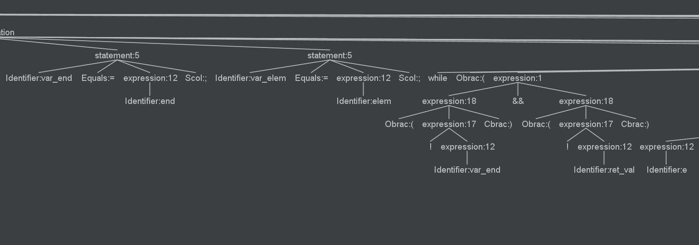

Slide 30
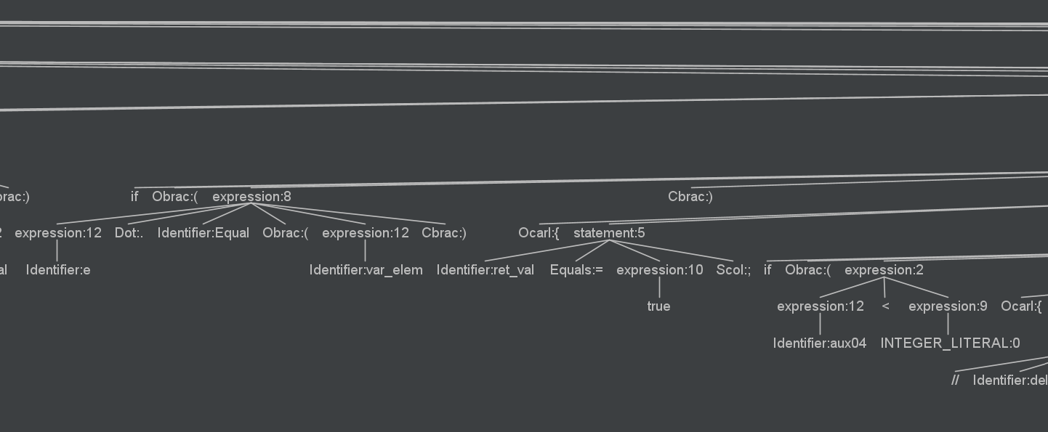
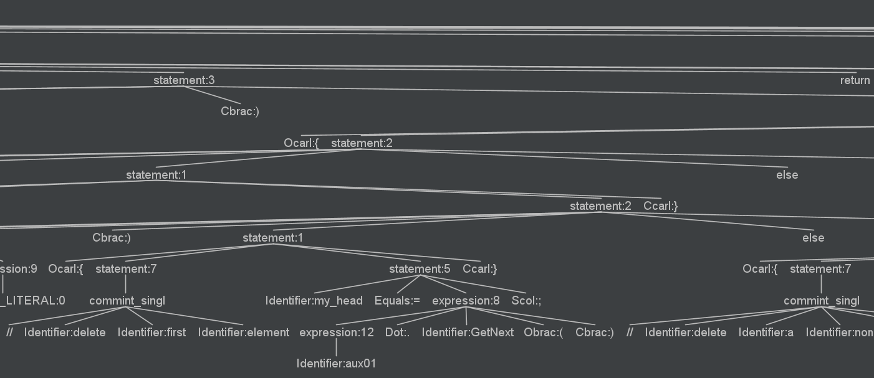

Slide 31
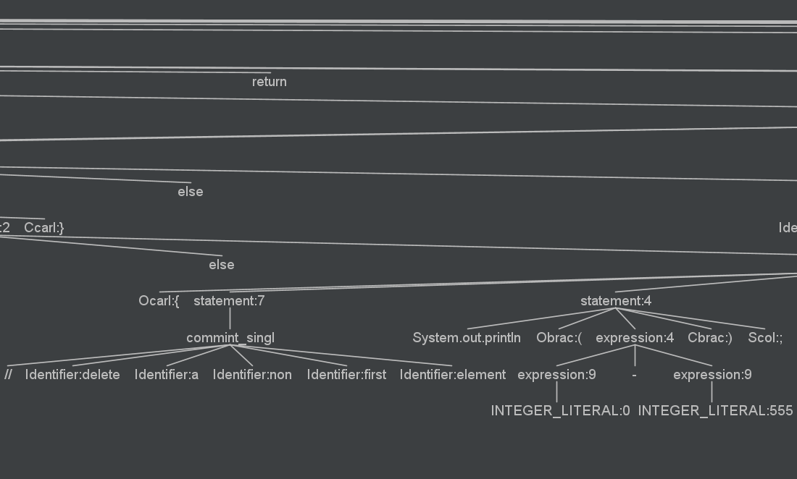
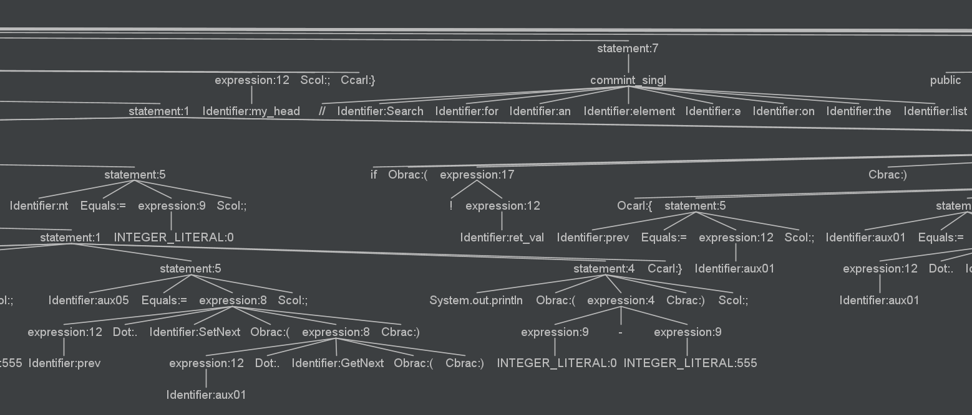

Slide 32
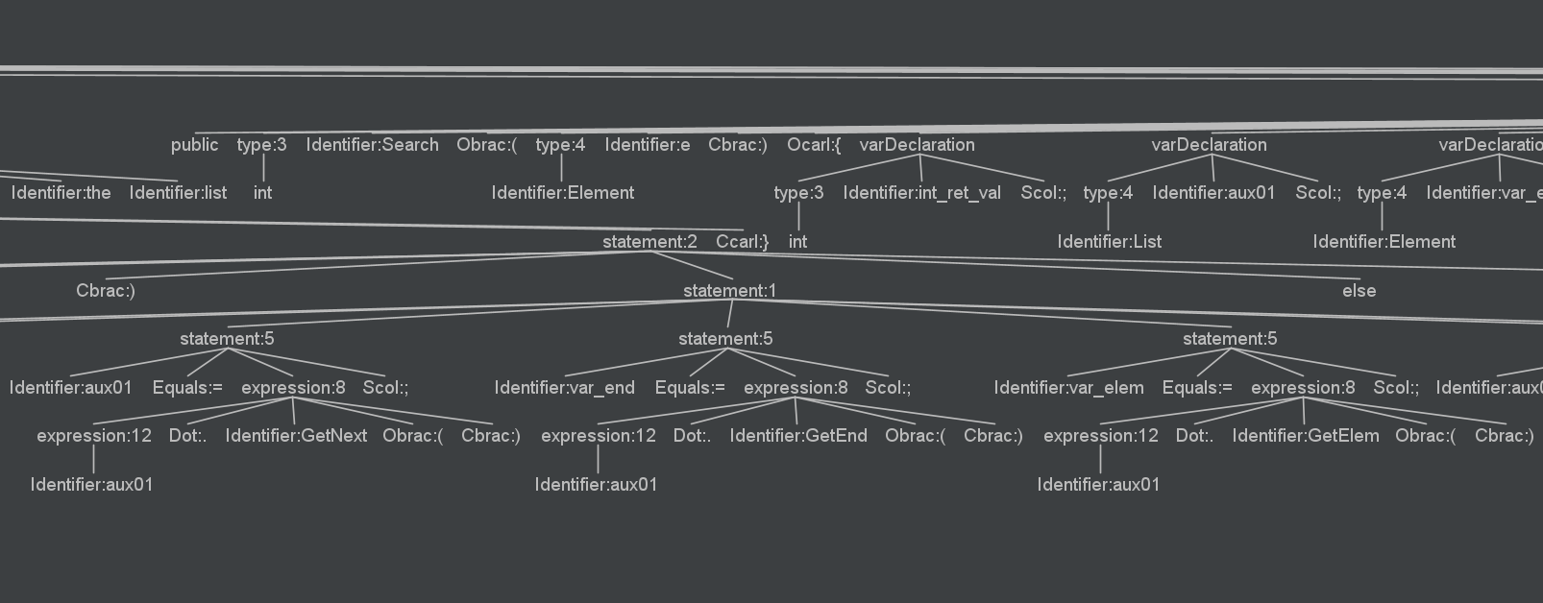
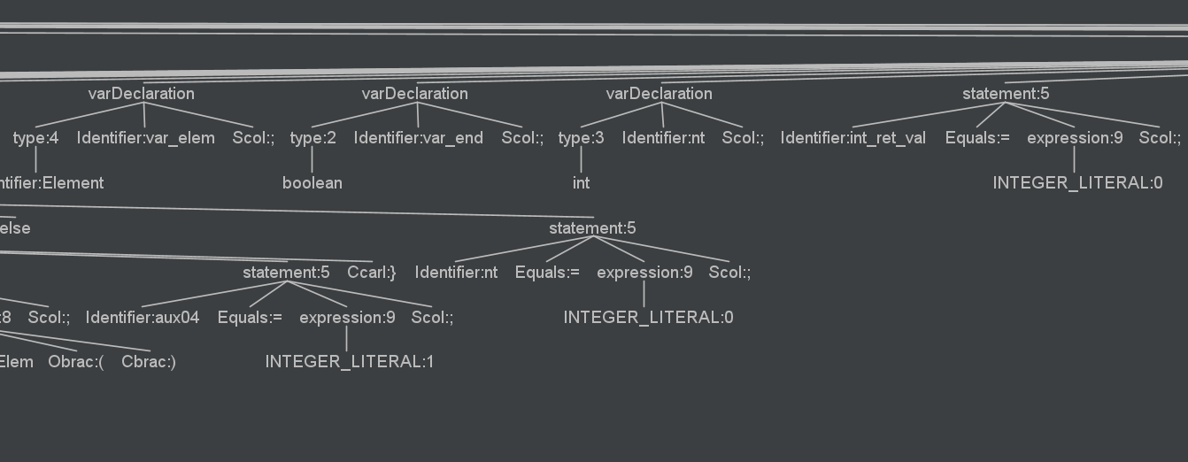

Slide 33
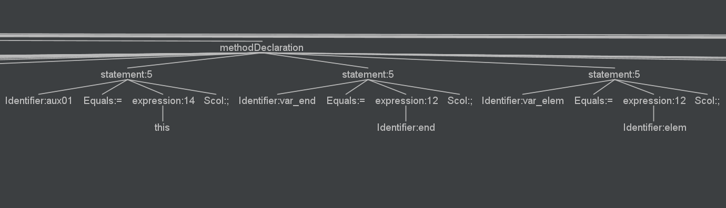
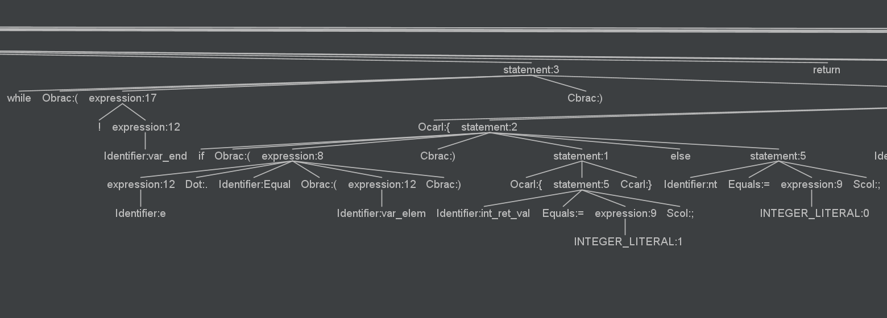
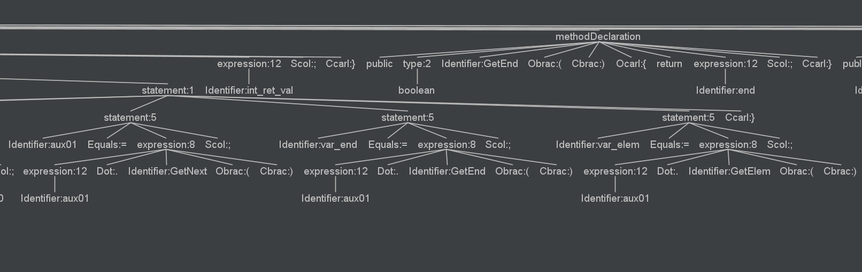

Slide 34
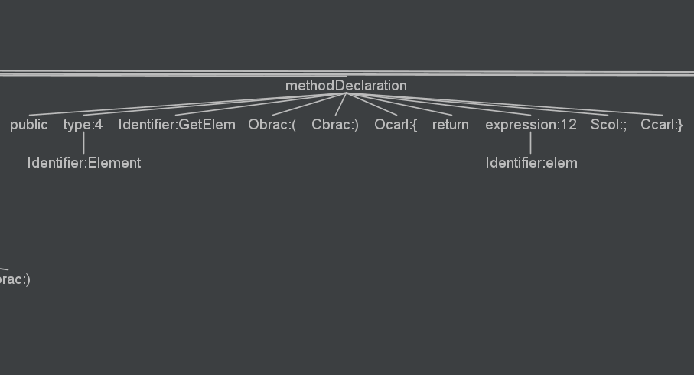
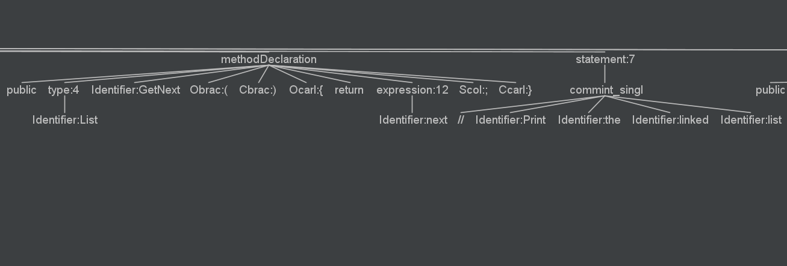
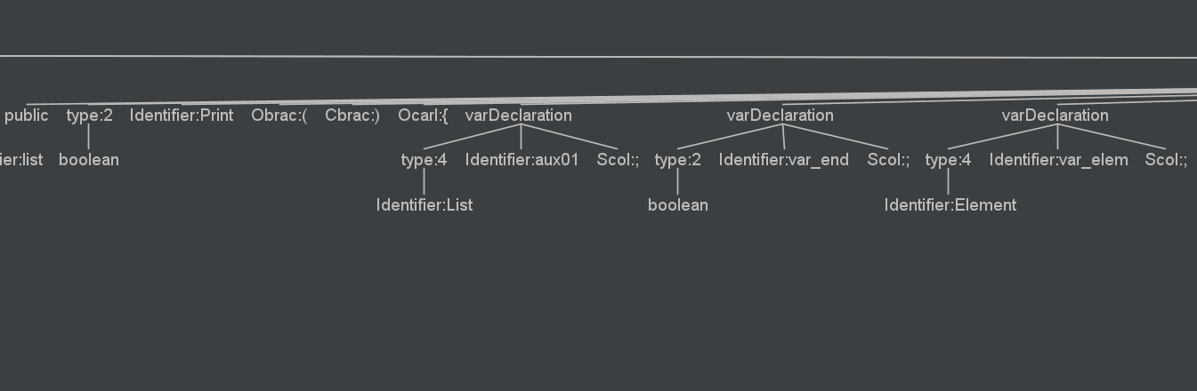

Slide 35
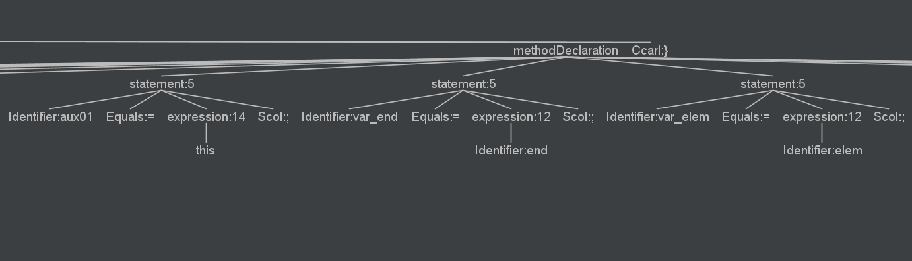


Slide 36


Slide 37



The team
1- farouk adel
1927231
2- norhan ali
1827219

Slide 38


THANK YOU

